Slide 1
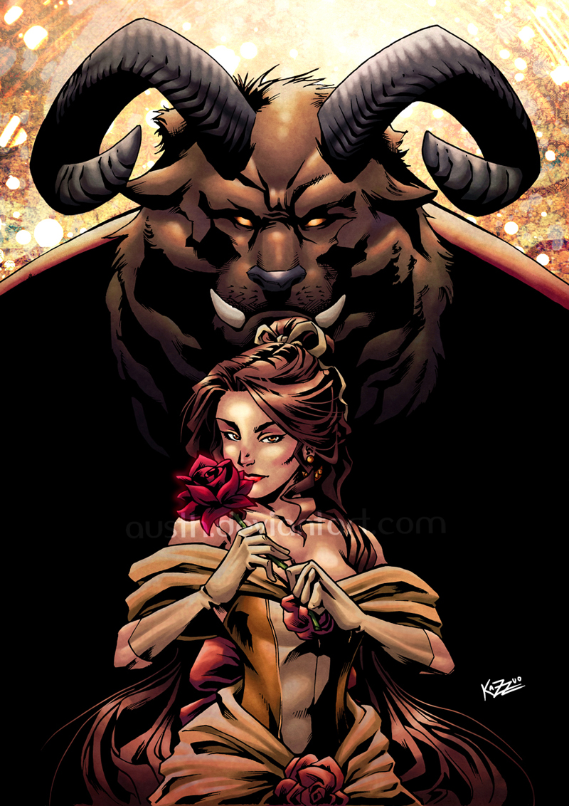
Themes: Example Page
This will be done in power point
1 Slide only
Will be submitted into schoology
This is an online assignment
Love
Follow the link: Theme quotes example 2
Select 4 different themes that mean something to you or that you think you can explain
Follow the instructions on this example page
Love is Blind

