Slide 1
Something Wicked This Way Comes
Take notes (I will help direct)
Summary after every chapter
Label every chapter in your notes
Notes are to be in word
Due after every reading assignment

Slide 2
Something Wicked This Way Comes
William Halloway
Jim Nightshade
Charles Halloway
Mr. Dark
Mr. Cooger
Miss Foley

Slide 3
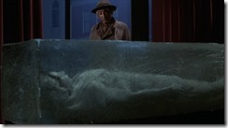

Slide 4
Ch. 21
Will and Jim arrive late to their homes after trying to warn Miss Foley
Will’s dad just tells him to “be careful”
Jim sneaks out from home late at night to return to the carnival to try to find Robert (Miss Foley’s nephew)
Will follows Jim as best friends do

Slide 5
Ch. 22
Jim spots Will as he is near Miss Foley’s house
Will tries to talk Jim into not going to the carnival
Jim admits he intends to ride the carousel and try to grow older
Will punches Jim and a fight ensues between the two boys
“Robert” walks out to see them, throws Miss Foley’s jewelry at the boys and shouts for the police and runs off
Miss Foley recognizes them and they start running

Slide 6
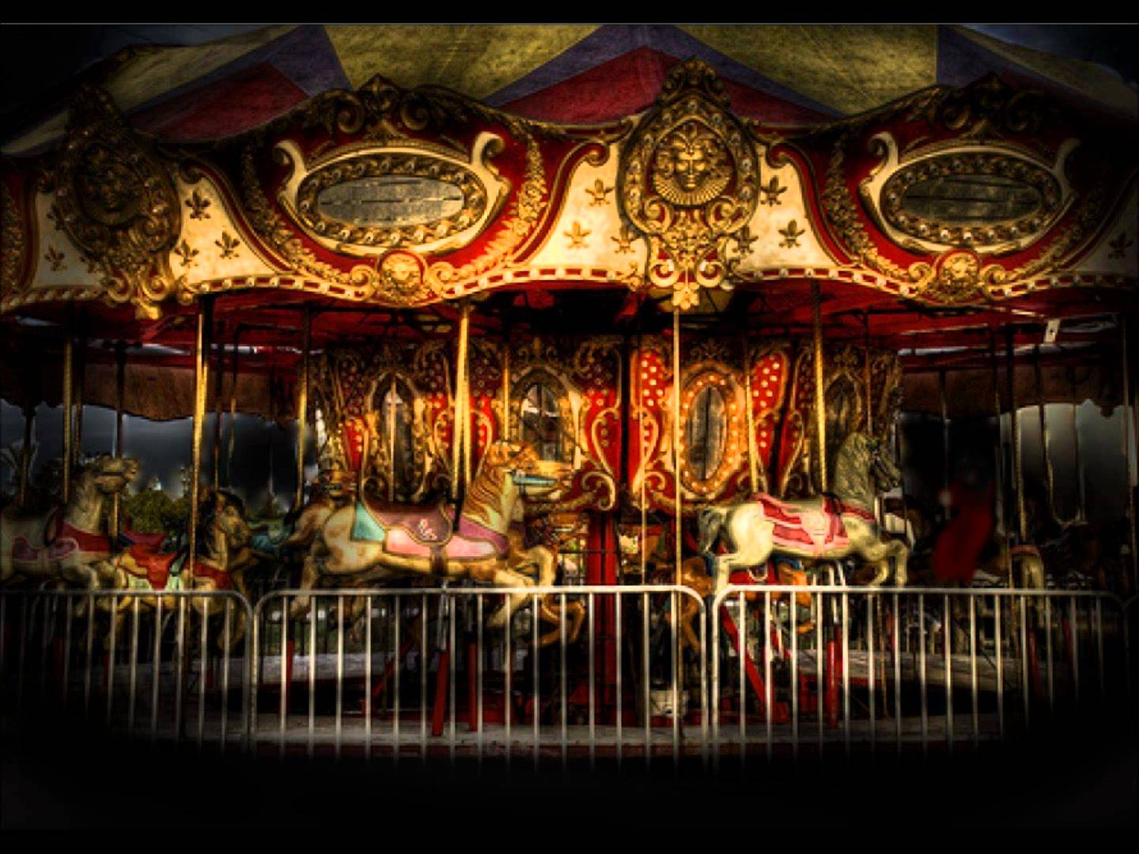
Ch. 23
The boys catch up to Robert at the carousel and Robert invites Jim to jump on as it spins forward
Something happens to the carousel and it begins to spin faster and many times with Robert aboard
The carousel spins up to ninety times, by the time it stops Mr. Cooger/Robert has aged to 120 or more years and looks like a mummy

Slide 7
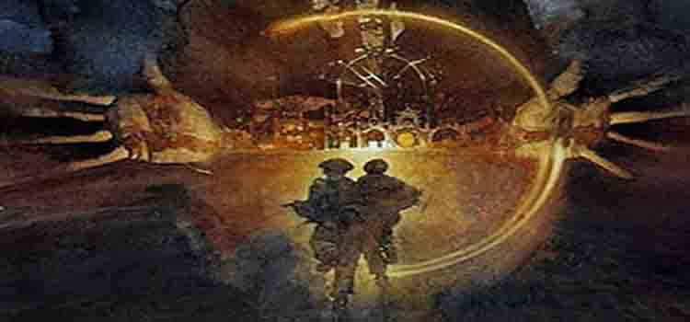
Check In
Make sure you are caught up on notes and summaries/reflections through Ch. 24

Slide 8
Ch. 24 II
The police begin to investigate what is going on at the Carnival
Mr. Dark works hard to convince them it is just a new act being assembled
Mr. Dark uses the electric chair to bring Tom Fury (Mr. Electrico) back to life
“Mr. Electrico” comes to life and the police are convinced this is all an act
Will and Jim lie about their names and Mr. Dark invites them to return to the carnival

Slide 9
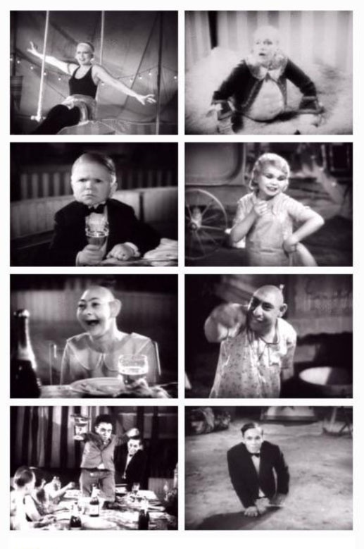
Pt II
Pursuits
Check in and catch up to make sure to have notes through Ch. 24
Notes Ch. 20-24 Will be due Friday…You will turn all notes in

Slide 10
Ch. 25
Miss Foley has it in her head that she must visit the carnival and ride the carousel
She feels that Robert is not her nephew, but is still drawn by him to the carnival
She contacts Charles Halloway

Slide 11
Ch. 26
The police deliver the boys back to town and they are faced with confusion as to what is next
Jim and Will disagree about what is next but pledge to support each other
Miss Foley contacted Charles Halloway to inform him she believes the boys stole her jewelry

Slide 12
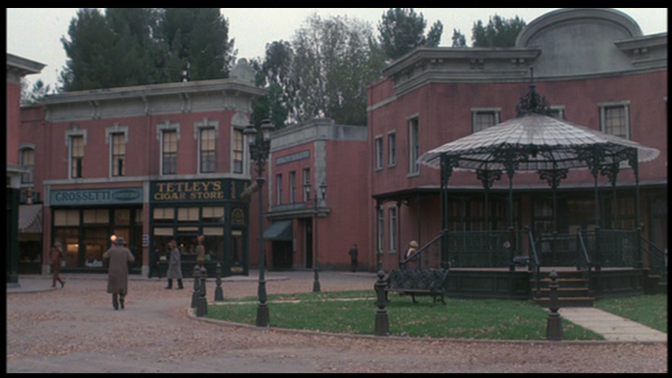
Ch. 27
Mr. Halloway walks the boys home and chats about being out late
Will begins to tell his father the reason for why they have been out late
He only gets as far as 3 am, but stops and promises to tell his father everything very soon

Slide 13
Ch. 28
Charles and Will talk together.
Topics: Age, regret, concern for “what is a good person”, death, and warning each other NOT to go near the carnival

Slide 14
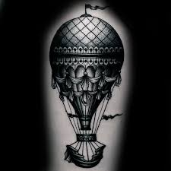
Ch. 29
Will awakens, as does Jim at the same time and realize the lightning rod has disappeared from Jim’s house
Jim admits he removed the contraption
The balloon from the carnival is hovering over their homes
The Dust Witch marks their home with a silver paint

Slide 15
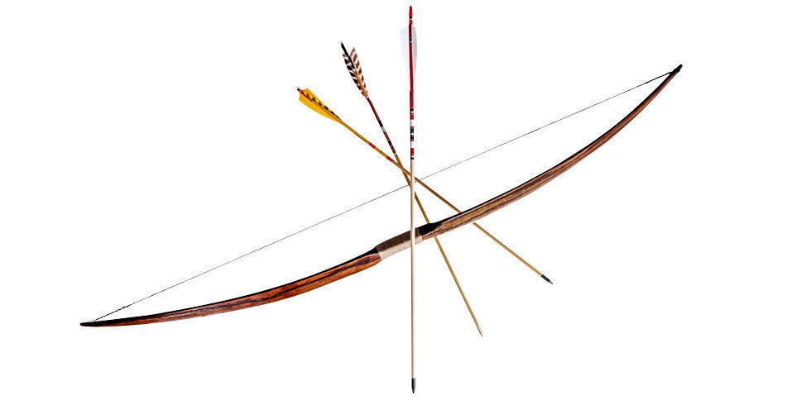
Ch. 30-31
Will decides to chase down the Dust Witch in the balloon with his archery materials (bow and arrow)
He heads for the Redman house…abandoned for years
After a game of “cat and mouse” with the witch he lands an arrow into the balloon causing it to hit the ground far off
He falls off the roof into a tree below

Slide 16
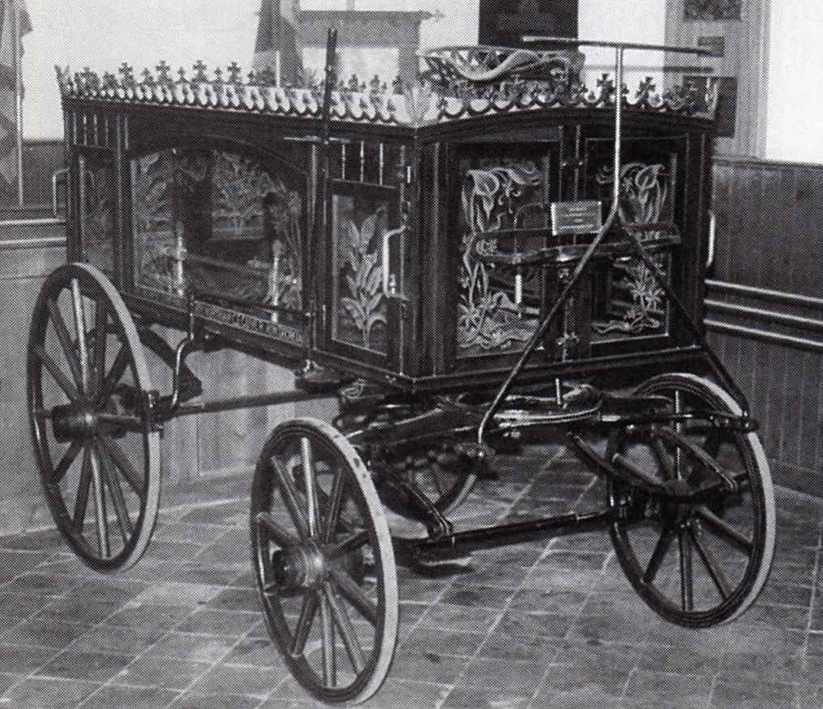
Ch. 32
The boys spot a young girl crying beneath a tree in town
They soon figure the young girl is Miss Foley who has grown younger due to the carousel
The boys soon discover the Carnival people are on the hunt for them in the form of a parade through town

Slide 17
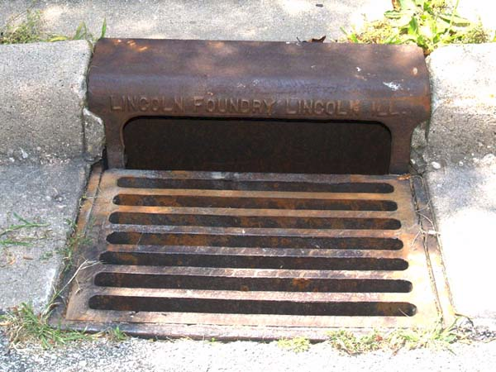
Ch. 33-34
Will calls his father to let him know he and Jim will be hiding out and won’t be around
The Carnival’s parade winds its way through the center of town
The parade halts and the boys know the hunt is on for them
Will’s dad is also looking for them
The boys are spotted by a small boy as they are hiding in the sewers

Slide 18
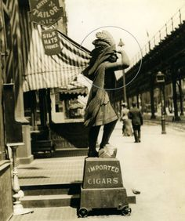
Ch. 35
The boy draws attention to Will and Jim hiding in the sewers…it is the former Tom Fury, now a dwarf, who sees them, but finally wanders away
Charles Halloway sees Mr. Dark in the café and hears Dark is searching for some boys
Charles walks to the cigar store, trying to not look obvious in a search for Will and Jim
Mr. Dark approaches him, asks if Charles knows the boys claiming they have won rewards and Charles makes up names
Mr. Dark declares Charles Halloway a liar

