Slide 1
Something Wicked This Way Comes
Take notes (I will help direct)
Summary after every chapter
Label every chapter in your notes
Notes are to be in word
Due after every reading assignment

Slide 2
Something Wicked This Way Comes
William Halloway
Jim Nightshade
Charles Halloway
Mr. Dark
Mr. Cooger
Miss Foley

Slide 3
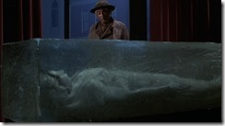

Slide 4
Ch. 21
Will and Jim arrive late to their homes after trying to warn Miss Foley
Will’s dad just tells him to “be careful”
Jim sneaks out from home late at night to return to the carnival to try to find Robert (Miss Foley’s nephew)
Will follows Jim as best friends do

Slide 5
Ch. 22
Jim spots Will as he is near Miss Foley’s house
Will tries to talk Jim into not going to the carnival
Jim admits he intends to ride the carousel and try to grow older
Will punches Jim and a fight ensues between the two boys
“Robert” walks out to see them, throws Miss Foley’s jewelry at the boys and shouts for the police and runs off
Miss Foley recognizes them and they start running

Slide 6
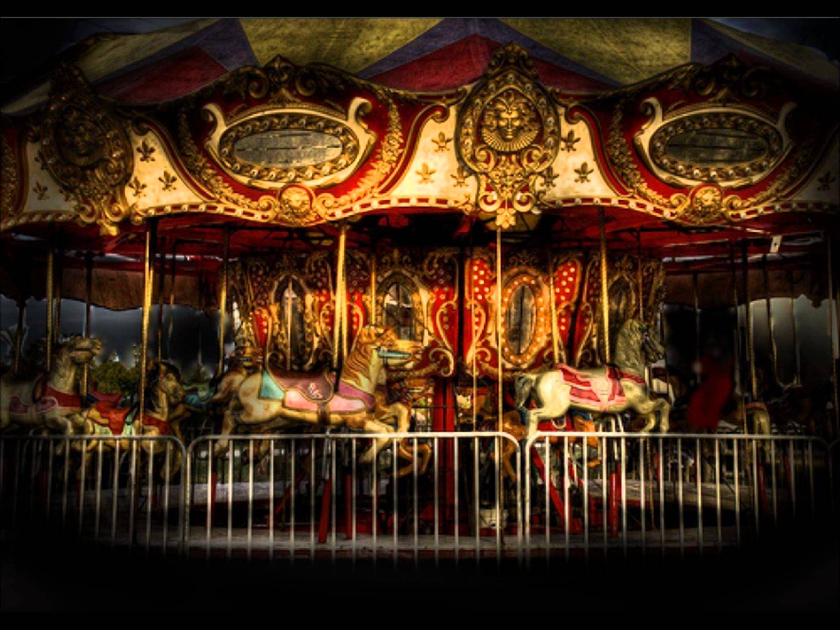
Ch. 23
The boys catch up to Robert at the carousel and Robert invites Jim to jump on as it spins forward
Something happens to the carousel and it begins to spin faster and many times with Robert aboard
The carousel spins up to ninety times, by the time it stops Mr. Cooger/Robert has aged to 120 or more years and looks like a mummy

Slide 7
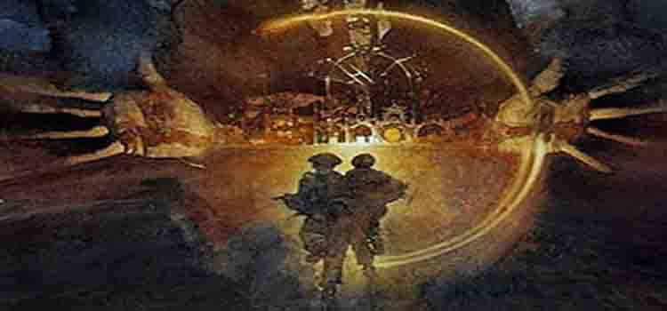
Check In
Make sure you are caught up on notes and summaries/reflections through Ch. 24

