Slide 1
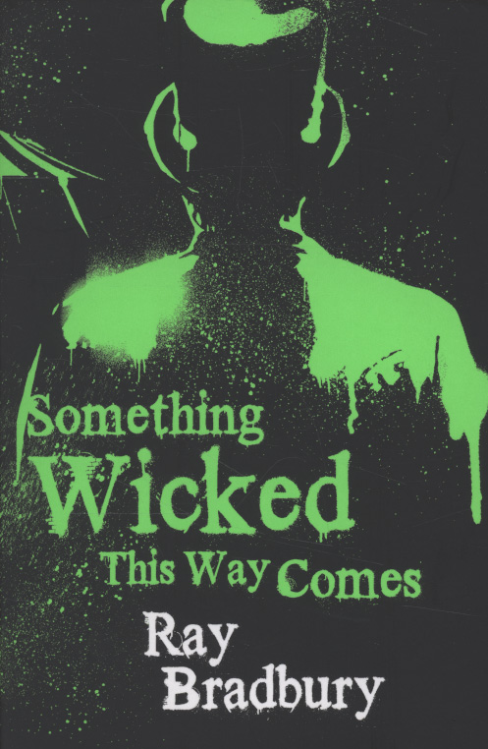
Something Wicked This Way Comes
Take notes (I will help direct)
Summary after every chapter
Label every chapter in your notes
Notes are to be in word
Due after every reading assignment

Slide 2
Something Wicked This Way Comes
William Halloway
Jim Nightshade
Charles Halloway
Mr. Dark
Mr. Cooger
Miss Foley

Slide 3
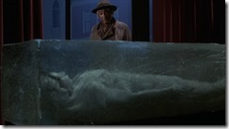
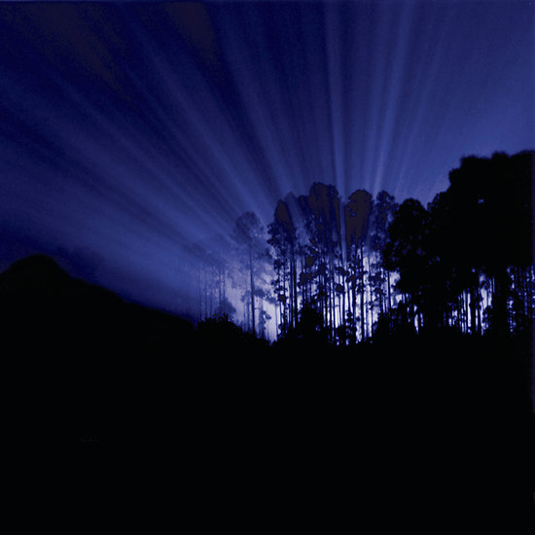

Slide 4
Ch. 21
Will and Jim arrive late to their homes after trying to warn Miss Foley
Will’s dad just tells him to “be careful”
Jim sneaks out from home late at night to return to the carnival to try to find Robert (Miss Foley’s nephew)
Will follows Jim as best friends do

Slide 5
Ch. 22
Jim spots Will as he is near Miss Foley’s house
Will tries to talk Jim into not going to the carnival
Jim admits he intends to ride the carousel and try to grow older
Will punches Jim and a fight ensues between the two boys
“Robert” walks out to see them, throws Miss Foley’s jewelry at the boys and shouts for the police and runs off
Miss Foley recognizes them and they start running

Slide 6
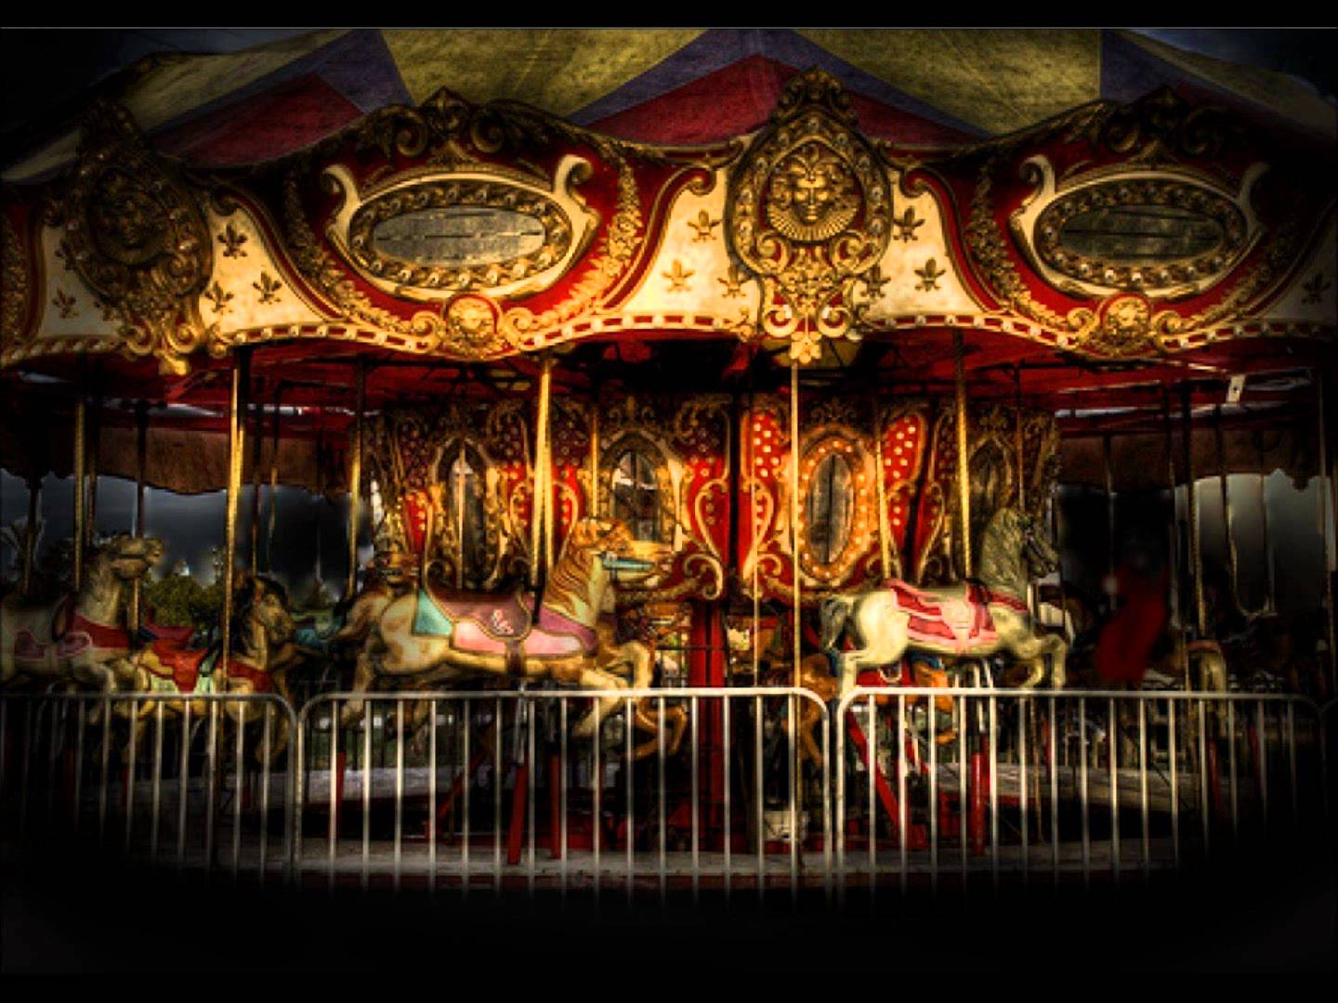
Ch. 23
The boys catch up to Robert at the carousel and Robert invites Jim to jump on as it spins forward
Something happens to the carousel and it begins to spin faster and many times with Robert aboard
The carousel spins up to ninety times, by the time it stops Mr. Cooger/Robert has aged to 120 or more years and looks like a mummy

Slide 7
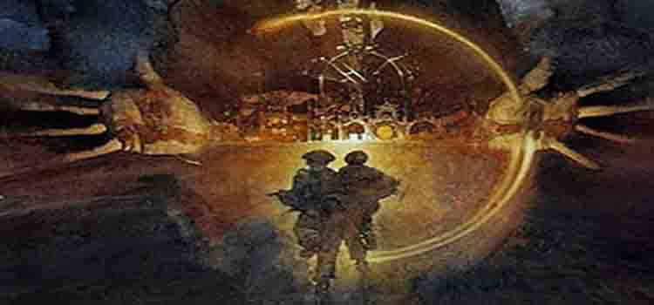
Check In
Make sure you are caught up on notes and summaries/reflections through Ch. 24

Slide 8
Ch. 24 II
The police begin to investigate what is going on at the Carnival
Mr. Dark works hard to convince them it is just a new act being assembled
Mr. Dark uses the electric chair to bring Tom Fury (Mr. Electrico) back to life
“Mr. Electrico” comes to life and the police are convinced this is all an act
Will and Jim lie about their names and Mr. Dark invites them to return to the carnival

Slide 9
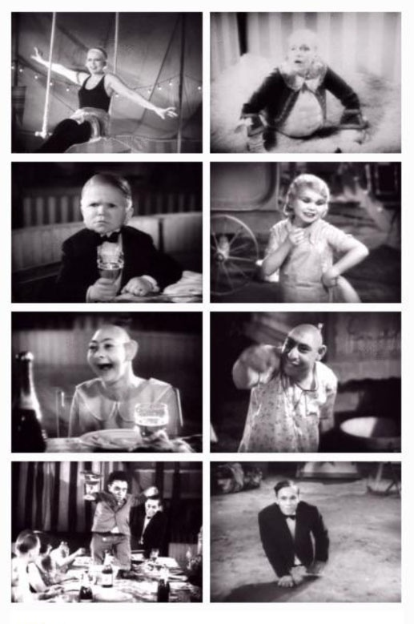
Pt II
Pursuits
Check in and catch up to make sure to have notes through Ch. 24
Notes Ch. 20-24 Will be due Friday…You will turn all notes in

Slide 10
Ch. 25
Miss Foley has it in her head that she must visit the carnival and ride the carousel
She feels that Robert is not her nephew, but is still drawn by him to the carnival
She contacts Charles Halloway

Slide 11
Ch. 26
The police deliver the boys back to town and they are faced with confusion as to what is next
Jim and Will disagree about what is next but pledge to support each other
Miss Foley contacted Charles Halloway to inform him she believes the boys stole her jewelry

Slide 12
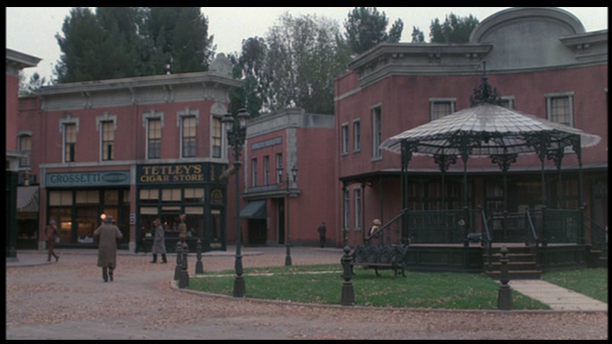
Ch. 27
Mr. Halloway walks the boys home and chats about being out late
Will begins to tell his father the reason for why they have been out late
He only gets as far as 3 am, but stops and promises to tell his father everything very soon

Slide 13
Ch. 28
Charles and Will talk together.
Topics: Age, regret, concern for “what is a good person”, death, and warning each other NOT to go near the carnival

Slide 14
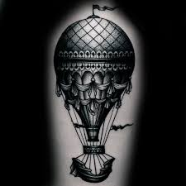
Ch. 29
Will awakens, as does Jim at the same time and realize the lightning rod has disappeared from Jim’s house
Jim admits he removed the contraption
The balloon from the carnival is hovering over their homes
The Dust Witch marks their home with a silver paint

Slide 15
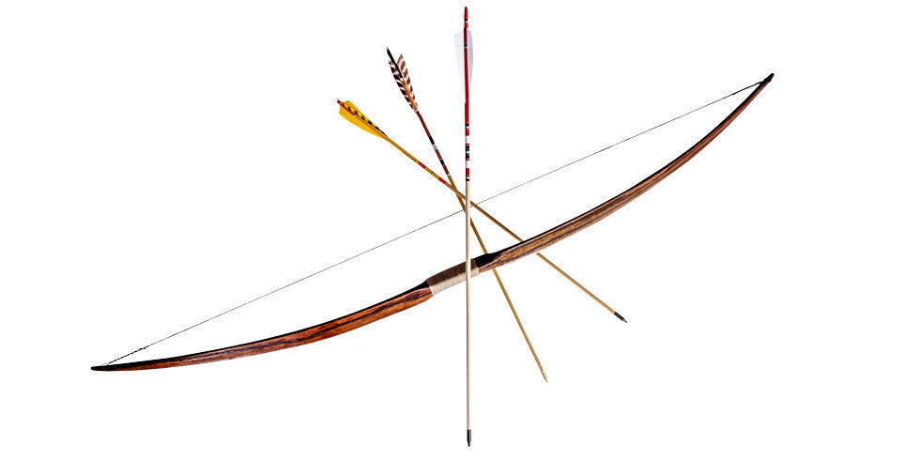
Ch. 30-31
Will decides to chase down the Dust Witch in the balloon with his archery materials (bow and arrow)
He heads for the Redman house…abandoned for years
After a game of “cat and mouse” with the witch he lands an arrow into the balloon causing it to hit the ground far off
He falls off the roof into a tree below

Slide 16
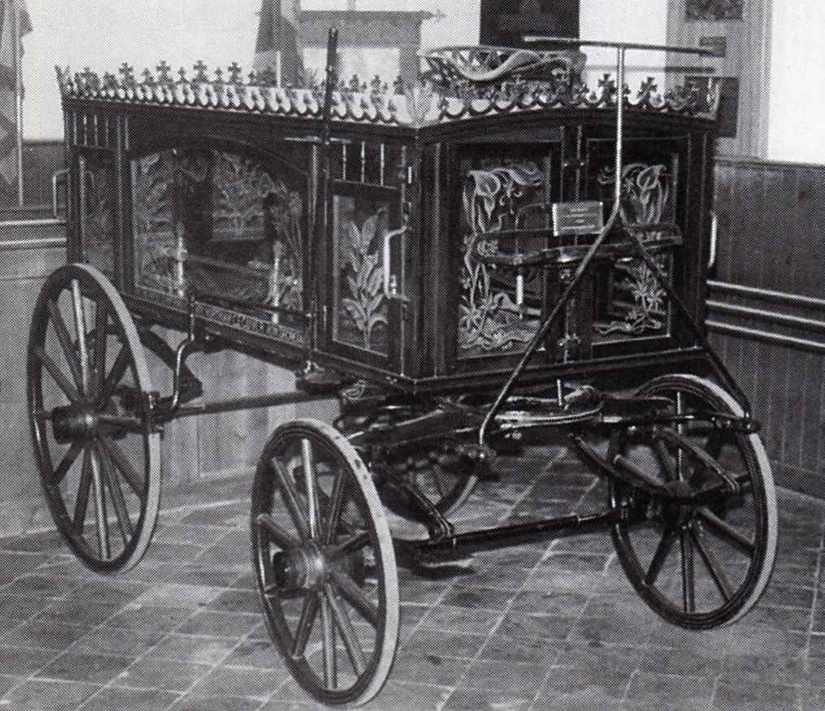
Ch. 32
The boys spot a young girl crying beneath a tree in town
They soon figure the young girl is Miss Foley who has grown younger due to the carousel
The boys soon discover the Carnival people are on the hunt for them in the form of a parade through town

Slide 17
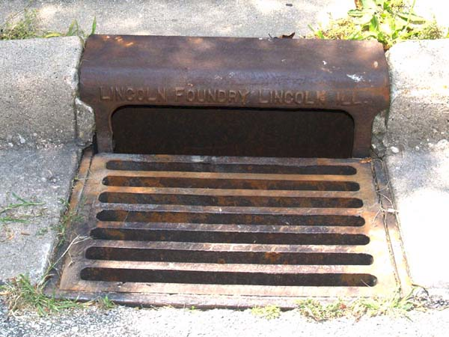
Ch. 33-34
Will calls his father to let him know he and Jim will be hiding out and won’t be around
The Carnival’s parade winds its way through the center of town
The parade halts and the boys know the hunt is on for them
Will’s dad is also looking for them
The boys are spotted by a small boy as they are hiding in the sewers

Slide 18
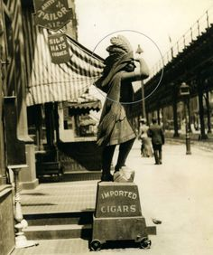
Ch. 35
The boy draws attention to Will and Jim hiding in the sewers…it is the former Tom Fury, now a dwarf, who sees them, but finally wanders away
Charles Halloway sees Mr. Dark in the café and hears Dark is searching for some boys
Charles walks to the cigar store, trying to not look obvious in a search for Will and Jim
Mr. Dark approaches him, asks if Charles knows the boys claiming they have won rewards and Charles makes up names
Mr. Dark declares Charles Halloway a liar

Slide 19
Ch. 35-36
Mr. Dark and Charles Halloway exchange a conversation regarding the boys
In the end, Mr. Dark uses his power to close his fists, causing blood to appear…this is a clear threat of harm
The Dust Witch appears seeming to know where the boys are hidden
Charles tells Dark his own name
The Dwarf tells Dark where he saw the boys but they have vanished from the sewer

Slide 20
Ch. 37
Charles Halloway is investigating the Carnival’s history
He searches books on the occult, the background on the Prince of Darkness, Dr. Faustus and simply books telling ugly pasts
He finds what he is looking for in Shakespeare:
“By the pricking of my thumb; Something wicked this way comes”
- Macbeth

Slide 21
Ch. 38
The boys and Charles finally find each other in the Library
He tells the boys he believes everything they are claiming
October 12, 1888: Newspaper headline Cooger and Dark’s Carnival
Headlines dating back to 1846 before Civil War
“Beware the Autumn People” is cited
Charles Halloway traces the history of these Carnival people back close to 100 years

Slide 22
Ch. 39
Charles Halloway delivers a monologue (one person speaking) about life…try not to regret and try to live it one day at a time)
Charles is trying to give the boys a reason and understanding to fight this evil
They come to realize what “fuels” the needs of the Carnival

Slide 23
Ch. 40
Charles explains that what the Carnival has to offer is evil
In exchange for a desire fulfilled. there are strings attached
The people have been changed for the worse by the Carnival
As Charles Halloway speaks, someone enters the library

Slide 24
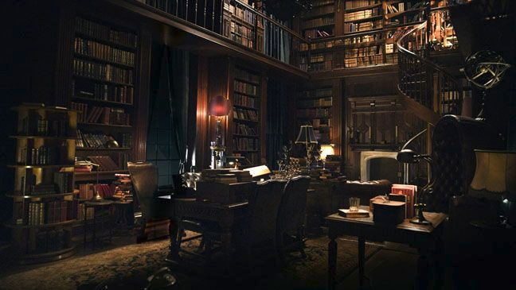
Ch. 41
Mr. Dark squares off against Charles Halloway
Dark has come looking for the boys
Dark makes it clear he can harm or kill Charles Halloway if he so chooses
Charles Halloway faces Dark with a bible and a hope only
Dark controls Charles’ heart and goes to search for Will and Jim

Slide 25
Ch. 42
Mr. Dark searches for the boys in the library
He tells Will that he put his mom on the carousel earlier and she spun forward over and over
Will sobs and gives away their hiding place
Mr. Dark finds them hiding on a high shelf

Slide 26
Ch. 43
Mr. Dark captures the boys from the library
Charles attempts to fight Mr. Dark, but he cannot
Will and Jim spot their mothers…both safe at the moment
The Dust Witch casts a spell on both boys stopping them from seeing, hearing and speaking
They are now captives of the Carnival People

Slide 27
Ch. 44
Charles Halloway faces the Dust Witch in the Library
She attempts to stop his heart and begins to succeed, but Charles finds an inner strength of laughter to help stop the curse
They go back and forth until the Dust Witch finally quits trying and leaves

Slide 28
Ch. 45
Will and Jim are paraded through town
Mr. Dark controls their every thought and action
Will tries desperately to escape the clutches of the carnival folk, but the spell is just too strong

Slide 29
Ch. 46
The parade ends at the carnival grounds and the boys have become like “wax” figures
Mr. Dark announces one last event of the evening: The Bullet Trick
The Dust Witch is to catch a bullet fired by a volunteer
The Dust Witch tries to warn Mr. Dark to not do the trick
A volunteer to fire the gun emerges from the audience: Charles Halloway

Slide 30
Ch. 47
Charles appears as the volunteer to fire the rifle in the Bullet Trick
Charles’ arm is useless so he calls for Will to help him
The entire crowd starts calling for Will so the Dust Witch must produce him
Charles etches in a ‘crescent moon’ into the bullet but it actually is his own smile (symbolizing happiness or goodness)
Charles and Will take the shot…

Slide 31
Ch. 48
Charles and Will take the shot…and kill the Dust Witch
Mr. Dark declares it is all part of the show
Charles and Will run to the maze to rescue Jim

Slide 32
Ch. 49 & 50
Charles and the boys hide in the mirror maze
Will tries to light a match, his dad tells him not to, and in that time Will acknowledges that he loves his father
Charles lets an incredible sound and Jim exits the mirror maze
All the mirrors break and Charles and Will leave the maze headed to the one place they know Jim will be…the carousel

Slide 33
Ch. 51
Mr. Cooger (Mr. Electrico) has been turned to dust…That is what Charles and Will believe
Charles and Will attempt to rescue Jim
Jim does not want to get off the carousel
Will winds up on the carousel with Jim and they begin to age…slightly
Charles stops the carousel

Slide 34
Ch. 52
A boy name Jed appears
We do not know the fate of Jim Nightshade
Charles Halloway figures out quickly that “Jed” is Mr. Dark
He made himself younger in order to trick Charles
The plan failed

Slide 35
Ch. 53
Charles defeats Mr. Dark (Jed) with the power of kindness and refusal to give in to evil
The wind arrives and the tents begin to collapse
This is the end of Cooger and Dark’s carnival and all the freaks involved
The skeleton man picks up the lifeless body of Mr. Dark and carries him away
Jim lies cold on the ground

Slide 36
Ch. 54
Will begins to cry at the death of his friend Jim
Charles knocks some sense into him telling Will that the sadness is just what they want to thrive
Jim teeters one foot in and one foot out of wherever he is…Charles explains Will should jump for joy with happiness to bring him back
The strategy works…Jim awakens and wants to know what happened
They take on last look and consider using the carousel
They walk away

