Slide 1
Something Wicked This Way Comes
Take notes (I will help direct)
Summary after every chapter
Label every chapter in your notes
Notes are to be in word
Due after every reading assignment

Slide 2
Something Wicked This Way Comes
William Halloway
Jim Nightshade
Charles Halloway
Mr. Dark
Mr. Cooger
Miss Foley

Slide 3
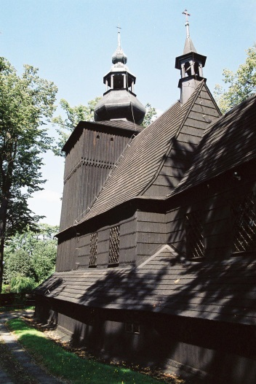
Ch 1 Notes
Boys meet the lightning rod salesman
Boys live next door, grown up together, share a birthday one minute apart
Jim Fury…Lightning rod salesman
William Halloway: Blonde, with hair as white as corn silk
Jim Nightshade: Dark messy hair
Give the boys a free lightning rod
Insists they put it on Jim Nightshades
house

Slide 4
Ch. 2 Storytelling and Setting
A visit to the library…we meet William’s dad Charles Halloway, an old man, the janitor librarian…winter face/summer face
Description: focus on the strength of their friendship.

Slide 5
Ch. 3 Storytelling and Setting
Focus on the strength of Jim and William’s friendship
Charles Halloway feels his age and misses his youth
Description: paper and leather…so many things happened…a factory of spices…travels around the world…
The boys hear “music” on the wind in the approaching storm

Slide 6
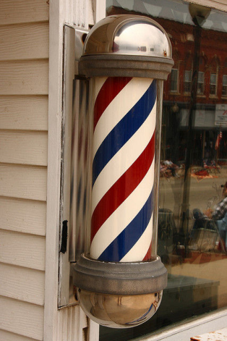
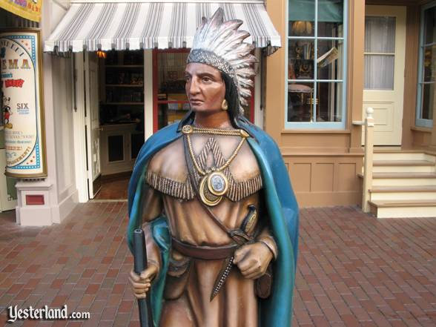
Ch. 4 Storytelling and Setting
Mr. Crosetti, the barber, smells licorice and cotton candy in the wind
Mr. Tetley, proprietor (owner) of the cigar store
What do you think the following mean:
The city was dead…
They stomp-pound-thundered over the iron grates and trapdoors…Jim and Will were the storm!

Slide 7
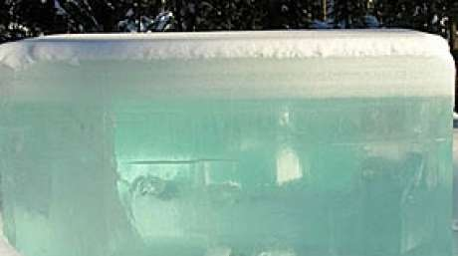
Ch. 5 Storytelling and Setting
Charles Halloway encounters a man pasting posters whistling a Christmas tune…in October
Charles notices for a brief moment the man’s palm is covered in fine black silken hair
Posters for Cooger & Dark’s Pandemonium Show
“The most beautiful woman in the world” is advertised
Block of ice on display in an empty storefront

Slide 8
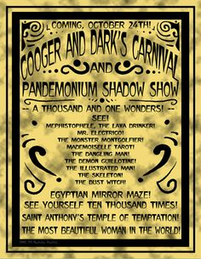
Ch. 6 & 7 Storytelling and Setting
The boys have a sense that “something is happening”
A paper blows towards them on the empty street
Cooger and Dark’s Carnival coming Oct 24.
Carnivals do not come this late in the year
All sorts of oddities advertised
The storm still approaches,
the sound of a calliope is
heard in the background

Slide 9
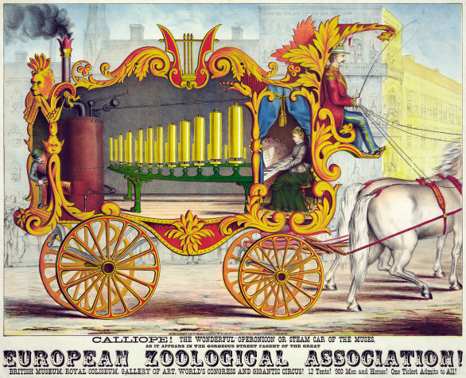
Ch. 8 Storytelling and Setting
Cooger and Dark’s Carnival causes uneasiness in Charles Halloway and his son Will
Will’s father has a fear he has not felt and is coming to terms with his age and how he feels he is not enough to provide for his wife and son

Slide 10
Ch. 9 Storytelling and Setting
Jim Nightshade is described
He has looked into the world and he is mature for 13
Will is much more innocent
Jim has lost two siblings and his father is gone

Slide 11
Ch. 9-15 Storytelling and Setting
Carnival sets up silently at 3 am
The boys sneak out to see no person anywhere…with the exception of a rider in a balloon, dressed all in black, who brings the carnival to life with a wave of his hand
Charles Halloway is worried about a carnival arriving at 3am
He finds the ice block melted and the beautiful woman gone
The boys attend the carnival during the day finding it is just a regular carnival
Miss Foley sees a woman drown in the mirror maze, who looks just like her when she was young
The boys are going to sneak into the carnival at night

Slide 12
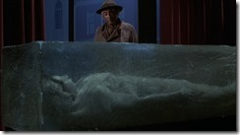
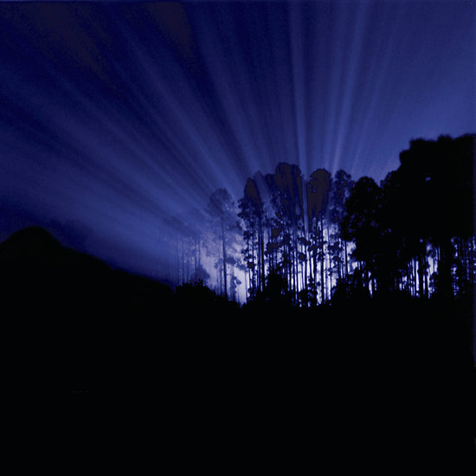

Slide 13
Ch. 16-18 Storytelling and Setting
The boys set out to see the carnival
They are caught looking at the carousel by Mr. Cooger and they meet Mr. Dark
Mr. Dark displays his work of moving tattoos/illustrations on his arm
Mr. Dark is pale, in all black
Mr. Cooger is strong, with red hair
The boys witness Mr. Cooger literally grow younger into a twelve year old boy by riding the carousel backward
Will and Jim know there is more to this carnival

