Slide 1
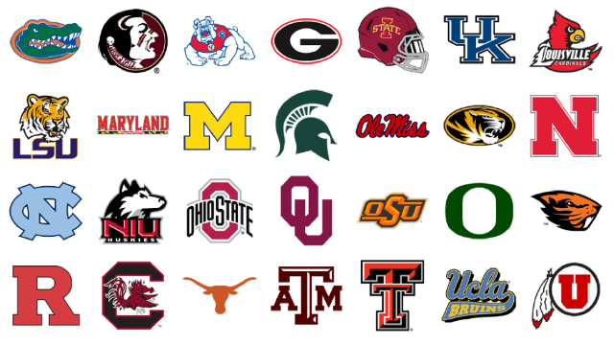
Drafting Into Word
Make sure to use your check off list provided to you
3 paragraphs (intro, body, conclusion)
All phrases need to be improved through re-structure or language
Follow the Format! All font 12 (times new roman or arial)
I will check in 25 minutes

Slide 2
What is due
1. 10 improved sentences
2. 3 individual paragraphs
3. 1 narrative (introduction, body, conclusion)

Slide 3
Paragraph
Complete: Introduction, Body, Conclusion
Read: Does it make sense?
Review: Punctuation, GUMS…
Edit: Change and strengthen words, phrases, descriptors
Edit: Tenses

Slide 4
Paragraph
Select 1 of your new expanded sentences
You will discuss in your group which sentence should be developed into a story
You will expand what you have with an introduction paragraph and a conclusion
3 paragraph narrative

Slide 5
Expanding Sentences
Select 3 three of the sentences you chose to improve
For each sentence: change nouns to proper nouns, and begin to develop a paragraph using sentences directly before or after your core sentence.
This will be developed into a narrative

Slide 6
Sentence Structure/Improving Sentences
Every sentence has a SUBJECT and a PREDICATE
A “Who” and a “Do”
A Noun and a Verb
Alternate parts of speech IMPROVE and add DETAIL
Verb tense changes the setting

Slide 7
Sentence Structure/Improving Sentences
The student was sitting.
The frightened student was sitting outside the Principal’s office.
The wide-eyed, frightened student was sitting nervously outside the intermediate school Principal’s office.

Slide 8
Sentence Structure/Improving Sentences
The wide-eyed, frightened student, who was brand new to the school, was sitting nervously outside the intermediate school Principal’s office, as the tiger slowly approached, licking its chops hungrily, a gleam of determination in its steely cat gaze.

Slide 9
Paragraph Development
Introduction
(3sentences) The wide-eyed, frightened student, who was brand new to the school, was sitting nervously outside the intermediate school Principal’s office, as the tiger slowly approached, licking its chops hungrily, a gleam of determination in its steely cat gaze. As the new student, Billy had never expected anyone to believe that a tiger was staring him down. Billy wondered if the rest of…
Conclusion

Slide 10
It was opening day at Wild Bill’s Intermediate school for circus performers, and the campus was abuzz with the sounds of trumpets blaring, future ringleaders calling out and pounds of make-up being plastered onto the faces of those hopeful to someday achieve the status of circus clown! In the hall of admission sat a lone student facing a soon to be life changing experience.
(3sentences) The wide-eyed, frightened student, who was brand new to the school, was sitting nervously outside the intermediate school Principal’s office, as the tiger slowly approached, licking its chops hungrily, a gleam of determination in its steely cat gaze. As the new student, Billy had never expected anyone to believe that a tiger was staring him down. Billy wondered if everyday at this place was going to be as nutty as today.
Billy bent forward and gave a whistle while extending his hand, motioning for the large cat to approach. The tiger was apprehensive, but slowly moved towards the seemingly frightened child. The tiger came with inches of Billy, extending it’s tongue to investigate this strange child. Without notice, Billy sprung on the helpless cat, Billy’s eyes ablaze and his fangs shooting out from his mouth. The tiger never knew what hit him as this infantile, vampiric creature thrust its fangs into the helpless feline. The tiger soon lay near death, as Billy grinned, licked his chops and sat down to await the meeting with his new Principal.

