Slide 1
Figurative Language Using figures of speech to be more effective, persuasive and impactful. Figures of speech such as metaphors, similes, allusions go beyond the literal meanings of the words to give the readers new insights.
A Review

Slide 2
Simile: A comparison that uses LIKE or AS
Hungry as a horse

Slide 3
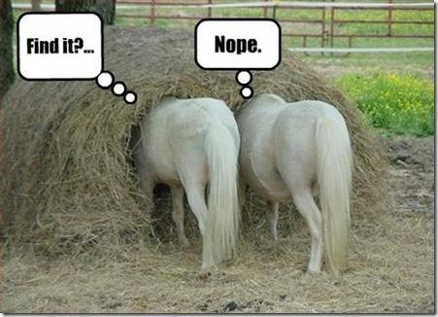
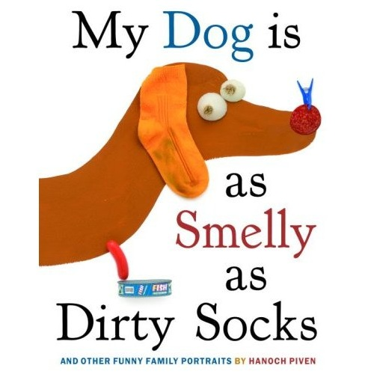
Similes
A SIMILE is a comparison that uses LIKE or AS
As big as an elephant
As hungry as a horse
As busy as a bee
As sharp as a razor
As white as a ghost
He eats like a pig
She smokes like a chimney
They act like animals

Slide 5
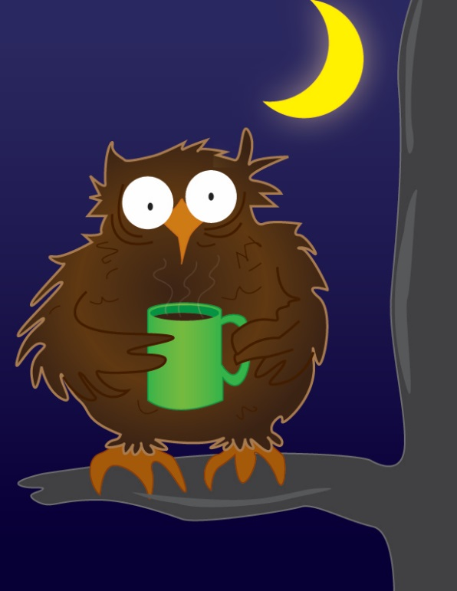
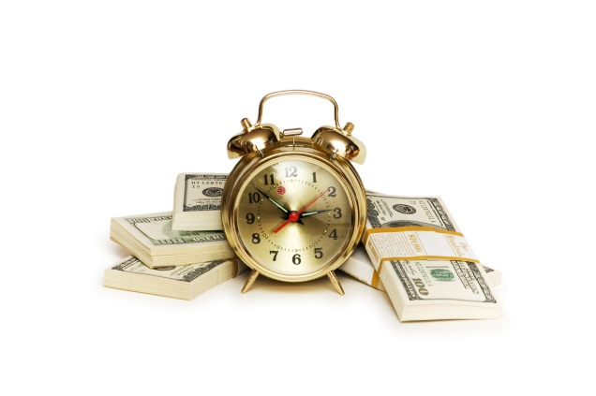
METAPHORS
A METAPHOR is a comparison that does NOT use LIKE or AS…It tells what something is
The snow is a white blanket.
America is a melting pot.
Her lovely voice was music to his ears.
Life is a rollercoaster.
The alligator’s teeth are white daggers.
Their home was a prison.
His heart is a cold iron.
She is a peacock.
He is a shining star.
Time is money

Slide 7
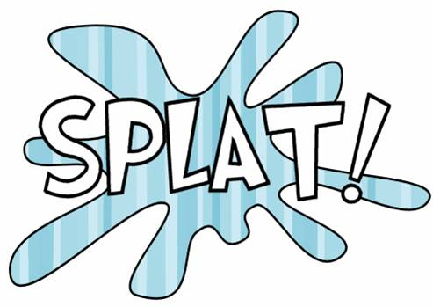
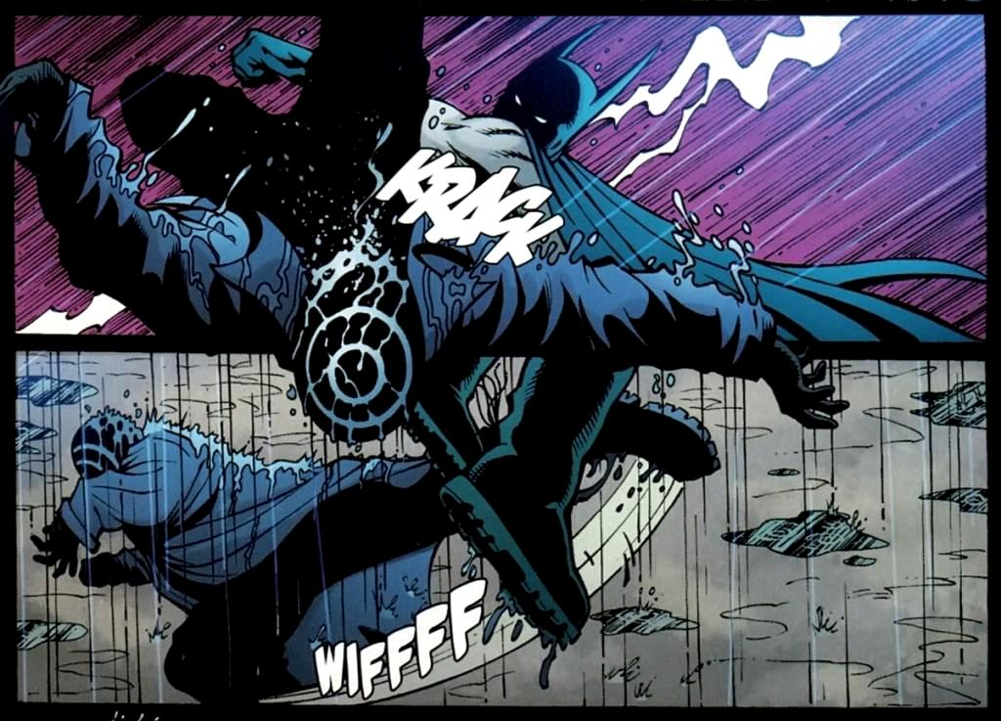
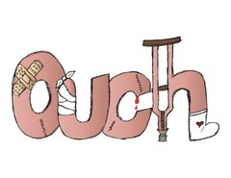
onomatopoeia
Onomatopoeia is when a word sounds like its meaning

Slide 8
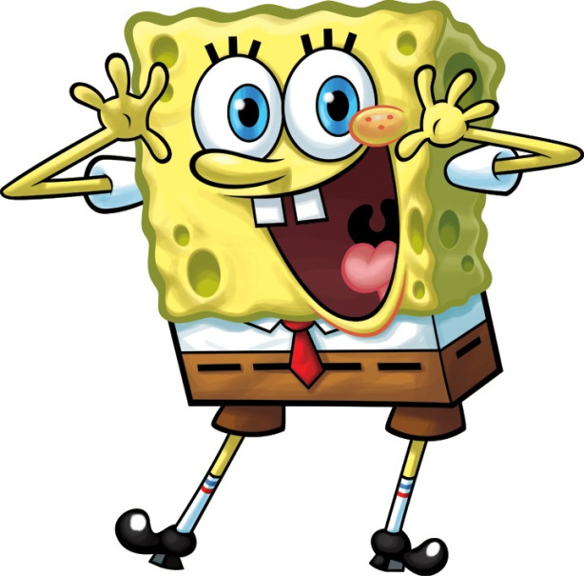
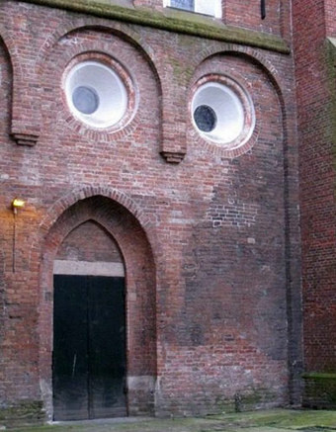
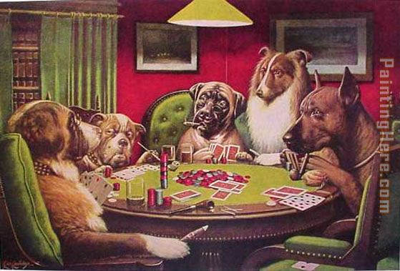
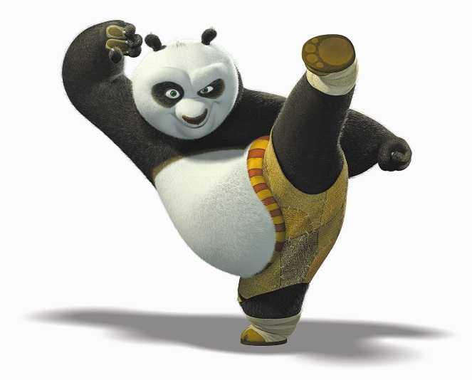
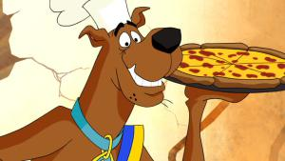
personification
Personification is when personal or human attributes are applied to something non-human

Slide 9
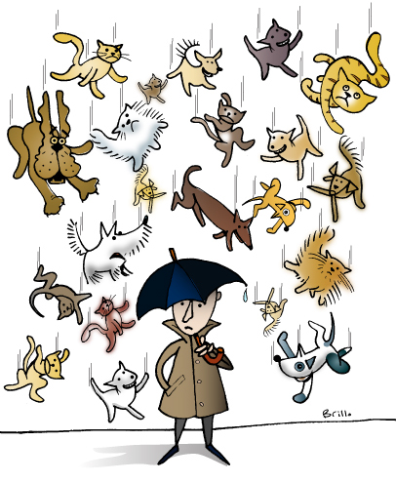
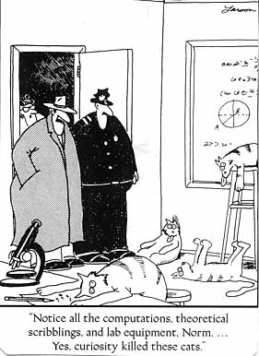
Idioms
Idioms are phrases or sayings that have inferred meanings rather than literal meanings
It is raining cats and dogs
It is easy as pie
Pay the Piper
Pushing up daisies
Bought the farm
Jump the gun
Out of the Blue
Break a leg
Curiosity killed the cat
Devil’s Advocate

Slide 10
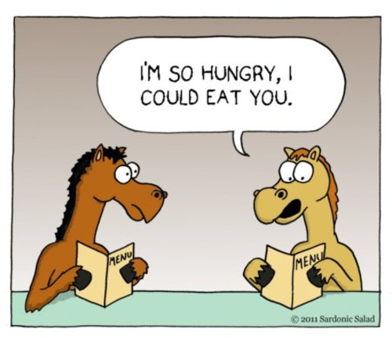
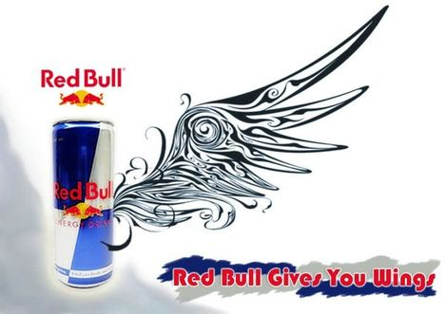
Hyperbole
Hyperbole are exaggerated statements, not to be taken literally…WAY over the top
I am so hungry I could eat a horse.
I have a million things to do.
I had to walk 15 miles to school in the snow, uphill.
I had a ton of homework.
If I can’t buy that new game, I will die.
He is as skinny as a toothpick.
This car goes faster than the speed of light.
That new car costs a bazillion dollars.
We are so poor; we don’t have two cents to rub together.
That joke is so old, the last time I heard it I was riding on a dinosaur.
They ran like greased lightning.
He's got tons of money.
You could have knocked me over with a feather.
Her brain is the size of a pea.
He is older than the hills.

Slide 11
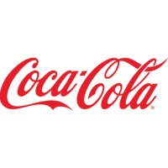
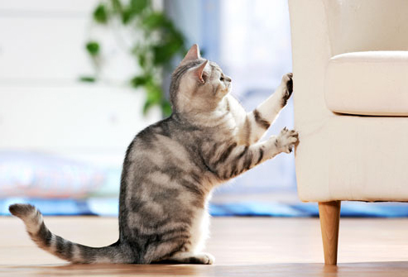
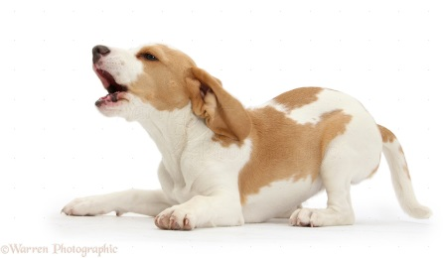
alliteration
Alliteration is when a statement or saying has the same first letter or consonent sound
Dunkin’ Donuts
PayPal
Best Buy
Coca-Cola
Chuck E Cheese
Alice’s aunt ate apples and acorns around August.
Becky’s beagle barked and bayed, becoming bothersome for Billy.
Carrie's cat clawed her couch, creating chaos.
Dan’s dog dove deep in the dam, drinking dirty water as he dove.
Eric’s eagle eats eggs, enjoying each episode of eating.
Fred’s friends fried Fritos for Friday’s food.

Slide 12
Symbolism
Symbolism is the use of symbols to represent ideas or qualities

Slide 13
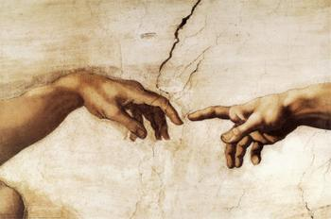
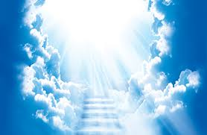
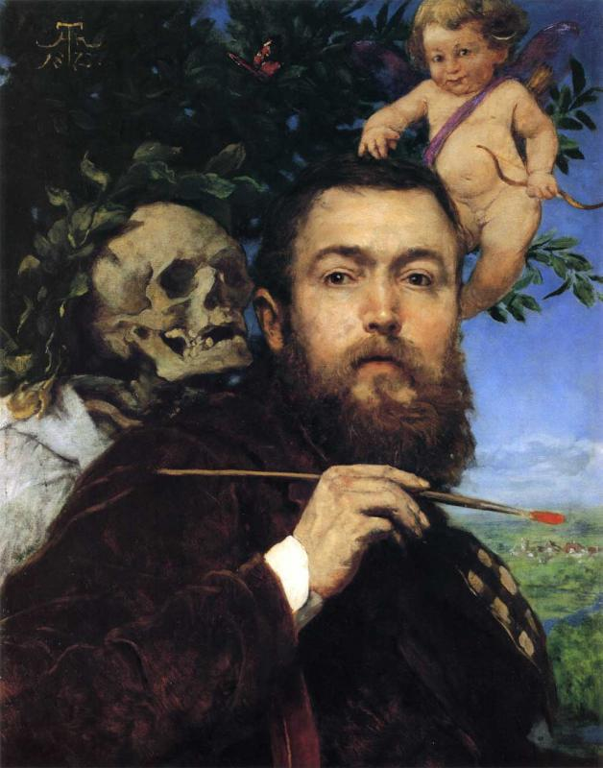
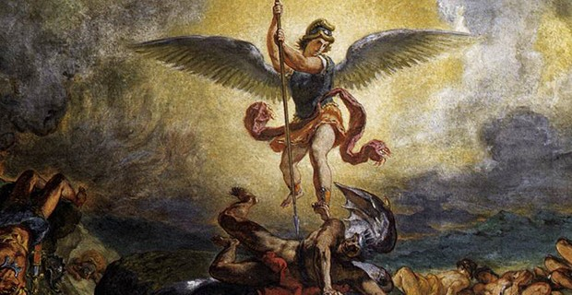
Symbolism
Symbolism is the use of symbols to represent ideas or qualities

Slide 15
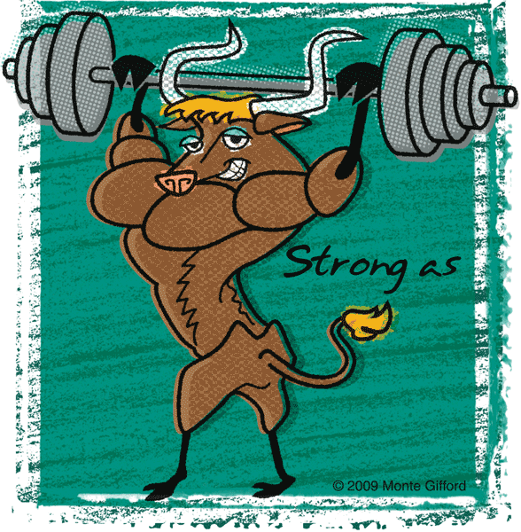
Simile: A comparison that uses Like or As
As strong as an ox

