Slide 1
Ch. 6 Cornell Notes
Big Ideas
Louisiana Purchase
Lewis and Clark Expedition
Westward Expansion
With the Louisiana Purchase, the size of the US doubled

Slide 2
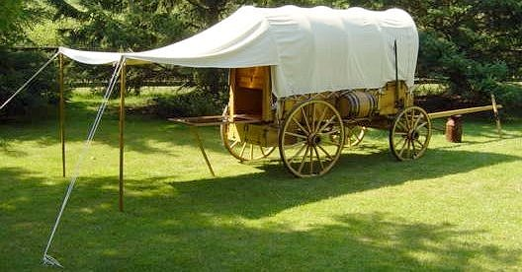
1800’s Westward Expansion
Louisiana Territory
Many Americans moved West
Traveled in Conestoga Wagons or “Prairie Schooners”
This area belonged to Spain
Spain secretly turned the land over to France
Pioneers faced trade embargo in the territory

Slide 3
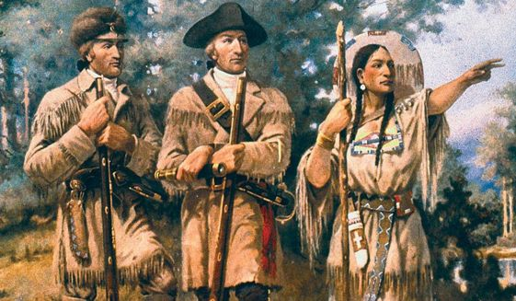
Louisiana Purchase
What was in the West?
Jefferson purchased the land for $15 million
Napoleon let it go as he no longer had interest in US land
Thomas Jefferson sent Meriwether Lewis and William Clark to find out
Ooh! I hope there is an In N Out! Mmmm.
Ok. We go that way 3,000 miles

Slide 4
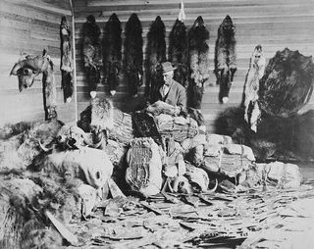
Lewis and Clark
Explorers who set out West
Called “Corps of Discovery”
Sacagawea (Native American) assisted them
Traveled from St. Louis, Missouri to the Pacific Ocean in Oregon territory
Introduced many Native Tribes, Fur Trapping, Hunting, Farming Lands and Unknown Creatures

