Slide 1
Ch. 5
The Federalist Era
Building a New Nation

Slide 2
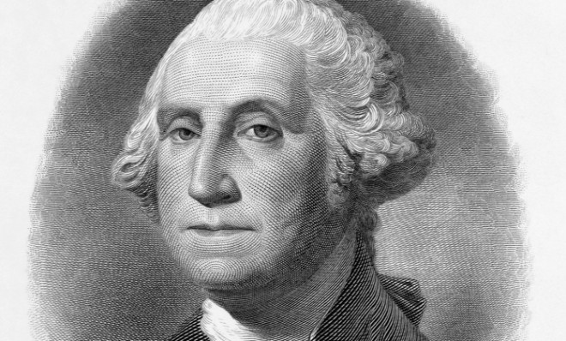
The First President
Concerns
Cabinet formed
Bill of Rights
April 30, 1789 George Washington elected first President of the United States
Would the new President act as a King?
Secretary of State
Secretary of War
Helped balance power/ease fears of the people

Slide 3
War costs money. Roads cost money. Public buildings cost money. Protection costs money…
Notes promising to repay money over time
Buyers and sellers of bonds (and later stocks)
National Debt
Bonds
Speculators

Slide 4
Hamilton’s Plan
Capital
Hamilton v. Jefferson
5 point plan (movie notes)
National Debt created (Basically Credit)
Washington DC (No single state ranks higher)
Hamilton: Federalist Conservative for large government/invest in corporate America
Jefferson: Republican Liberal for less government/Invest in Agricultural America

Slide 5
Whiskey Rebellion
What was the lesson learned?
Taxes on whiskey and resources caused a rebellion
Powerful new militia
Stopped the rebellion
Washington made it clear: If citizen’s want change, it must be peaceful and through due process

Slide 6
First Political Parties
Federalists
(Democratic)-Republicans
Differing parties formed for different reasons
Alexander Hamilton
Conservative, Wealthy, Strong Central Government, Constitution
Thomas Jefferson
Liberal, rule by the people, Decentralized Government, Constitution

Slide 7
Naturalization Act
Alien Act
Sedition Act
Required aliens (non-citizen immigrants) to reside 14 years instead of 5 in US
Allowed imprisonment or deportation of aliens considered a danger
Became a crime to speak or write against the government

Slide 8
Quiz Topics
You will study and know only 1 topic of your choosing. You will be required to write what you know with a thorough answer.
Explain Alexander Hamilton’s plan and the results of the plan
Explain the different beliefs between the Federalists and Democrat-Republicans
Explain the Whiskey Rebellion and what was the outcome
Explain the Alien, Naturalization and Sedition Acts. Explain how they were unfair and if you feel they would be supported in today’s society

