Slide 1
Ch. 4 Cornell Notes Sec. 1 Goals of the Constitution 1 Constitution 6 Goals 7 Principles 10 Amendments

Slide 2
Preamble (introduction) to the Constitution
6 Goals of the Constitution
A Perfect Union: Cooperate on major issues
Establish Justice: Equal laws and rights
Domestic Tranquility: Keep peace and feel safe
Provide Common Defense: Develop and maintain armed forces
Promote the General Welfare: A decent livelihood
Secure the Blessings of Liberty: No citizens rights may be taken away

Slide 3
7 Major Principles
People are the source of power
People elect their representatives
Limited government
National and State rules and laws
3 branches of government each with their own responsibilities
Checks and balances
Basic liberties and rights for all citizens guaranteed

Slide 4
The Federal System (how power is distributed)
Enumerated Powers = National Government
Reserved Powers = State Government
Concurrent Powers = Shared Government

Slide 5
The Bill of Rights
Free Speech, assembly, press and religion
Militia and own weapons
No taking over private homes
Illegal to search or take things without cause or a warrant
Cannot be deprived of life, liberty or property…due process

Slide 6
The Bill of Rights
Speedy trial, public trial by a jury with representation
Right to jury trial for lawsuits
No cruel or unusual punishment or excessive bail
Rights not restricted to these amendments
Balances state and federal powers

Slide 7
Ch. 4 Cornell Notes Sec. 2 The Federal Government 3 Branches

Slide 8
Legislative Branch
Impeachment
Constituents
Senate: 100 Senators, 2 from each state
House of Representatives: 435 Representatives, Amount varies based upon population
Their job is to make the laws, approve spending and approve taxes
Bring charges against any federal official
Citizens in their district

Slide 9
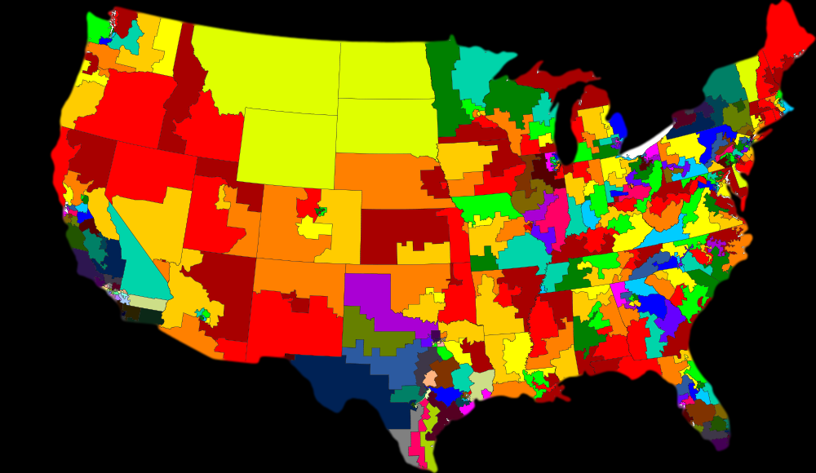
Representative Districts
Discussion: What do you notice?

Slide 10
Executive Branch
Cabinet
President
Chief Executive: Carries out the laws
Commander in Chief: Head of the military
Chief Diplomat: Oversees foreign relations
Chief of State: Represents all Americans to the world
President’s appointed department leaders

Slide 11
Judicial Branch
The Federal Court System
Settles disputes and interprets laws
Supreme Court makes all final decisions
They rule if any laws or behaviors are legal or “Unconstitutional”

Slide 12
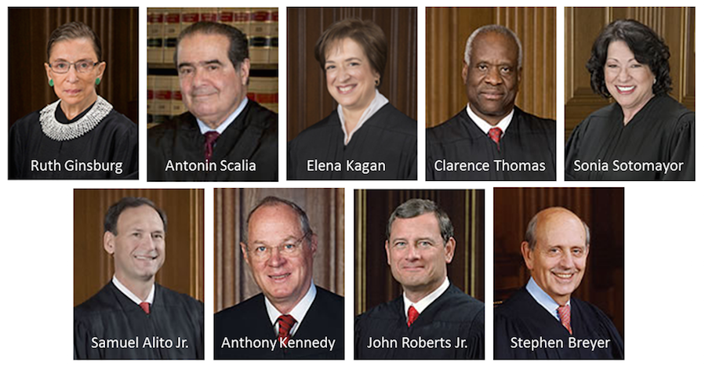
Current Supreme Court

Slide 13
Court Decisions
A court decision is used to make judgments
You see two names on cases
Plaintiff: the entity bringing charges
Defendant: the entity defending against the charges

Slide 14
Court Decisions
Civil: money or compensation
Criminal: lawful or criminal

Slide 15
Cases affecting history
Plessy v. Ferguson
Marbury v. Madison
Brown v. Board of Education
Rulings:
Separate but equal for schools and facilities
Supreme court rules on constitutionality of laws
Overturned Plessy v. Ferguson
Schools were integrated

Slide 16
Cornell Notes Constitution Components Articles Amendments

Slide 17
Article I
Created the Legislative Branch
Congress: Senate and House of Representatives
Powers:
Pass Laws
Impeachment Powers
Create and Collect Taxes
P. 252-253 Specific Powers

Slide 18
Article II
Created the Executive Branch
Office of President and Vice President
Qualifications: Citizen of US by birth, 35 years at least, resident of the US for at least 14 years
Powers:
Military Chief
Cabinet Appointments
Pardons for crimes
Executive Order: Override the Constitution (temporarily)

Slide 19
Article III
Article IV
Created the Judicial Branch: Supreme Court
Basically interpret the Constitution
Federal laws and rights apply in all states
States work with the Federal government

Slide 20
Article V
Article VI
Article VII
Rules for amending the Constitution
The Constitution is the “Supreme Law of the Land”
Ratification (voting to accept the Constitution…1788)

Slide 21
Bill of Rights
Remaining Amendments
Need to know
Amendments I – X (1791)
Amendments XI – XXVII (1795-1992)
Bill of rights
Voting Rights Amendments
Abolition of Slavery Amendment
Rights of Citizens Amendment

Slide 22
Ch. 4 Section 3 Citizen’s Rights and Responsibilities

Slide 23
Due Process
Equal Protection
Government must follow the rules or procedures for ALL people
14th Amendment: All people are granted equal rights and protections under the Constitution

Slide 24
Citizen
A person who owes loyalty to and is entitled to the protection under our Constitution
Born or Naturalized (Must know English and basic history and government of US)

Slide 25
Duties of all Citizens
Responsibilities of Citizens
Obey the law
Pay taxes
Defend our nation
Know what is going on involving government and people’s rights
Participate in the election process
Maintain respect for your community and environment
Respect others rights (Golden Rule)

