Slide 1
CH. 3 A More Perfect Union Sec 1 Articles of the Confederation Sec 2 Convention and Compromise Sec 3 A New Plan of Government

Slide 2
Forming a New Government
Why form a central government?
There was a need to create a central, or national government
Establish a military
Enforce laws and taxes
Equality and voice for all
Reach compromise faster
United States are stronger than separate states

Slide 3
Articles of the Confederation
Major Problems
Second Continental Congress met and wrote the first constitution
Confederation: separate states joining together
The new government could not collect tax money or enforce its laws

Slide 4
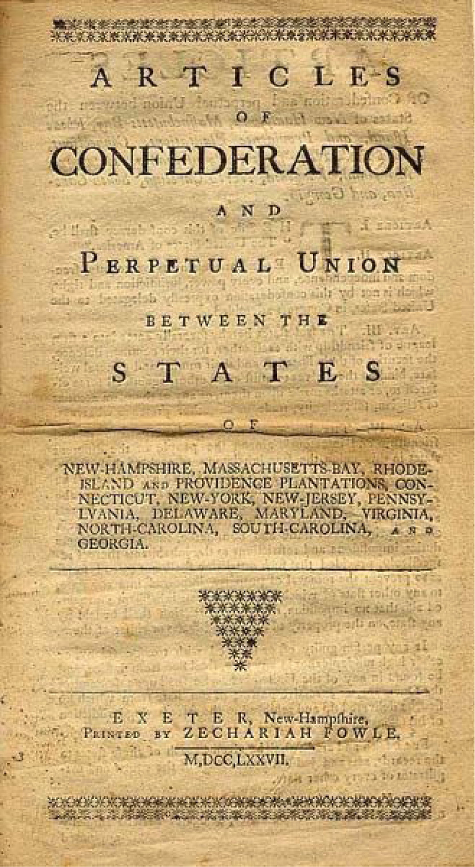
Why were the Articles weak?
Nine states needed for approval
No actual single leader to preside
Congress could not really enforce anything
Could not add or recognize new states
States had all the power

Slide 5
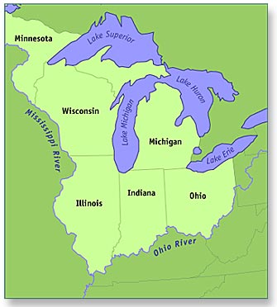
Westward Expansion
Northwest Territory created
With enough land, new states could be formed
Be aware of new formation of states
Northwest Ordinance: Created the Northwest Territory

Slide 6
Land, Trade and Debt
US was bankrupt
Cost of all goods went up
British were set to control all trade again
Spain wanted to keep their settled lands

Slide 7
Thirteen Independent States
Governments Formed
After the Declaration of Independence each state wrote their own set of rules
Each state wrote their own Constitution
Bicameral: Two Houses
Governor
Legislature

Slide 8
Elections
Popular Sovereignty
Popular Election
Usually landowners could vote
Wealthy white males
Equal Justice under the law
The laws and rights applied equally for all citizens
Some states offered this right to slaves and other groups
States collected taxes

Slide 9
Preserving Rights
Most rules based upon ideals of freedom
Citizens have rights
Citizens have equal protection
Government should be limited

Slide 10
CH. 3 A More Perfect Union Sec 2 Convention and Compromise

Slide 11
After the Articles
Depression
Shay’s Rebellion
Articles of Confederation did not succeed
When economic activity slows and unemployment increases
Colonists are upset over the new attempt at a central government
Danial Shay led a rebellion for farmers
They wanted to have their debts dissolved

Slide 12
Slavery
How to fix the problems of The Articles?
Slavery was legal
Between 1783 and 1804 most northern states ended the practice of slavery
Southern states did not
Races were separated (schools, churches, trades)
James Madison and Alexander Hamilton called for a new convention to try again

Slide 13
The Constitutional Convention
It was agreed to try again to become one nation, not separate states
George Washington was asked to preside over the delegation
Each state had one vote for each topic
Goal: Create rules and establish laws and rights for all the citizens*
*women, native americans and slaves were not recognized

Slide 14
The Virginia Plan
The New Jersey Plan
Two House Legislature
People and Representatives vote for representation
Proportional Representation: More population in a state = More representatives
One House Legislature
One voter per state only
Only made Articles of Confederation Stronger

Slide 15
The Great Compromise
Ben Franklin and Roger Sherman
Compromise: an agreement between two or more sides. Each side usually gives something up.
Two House Legislature
1. House of Representatives: Proportional to the population
2. Senate: 2 members from each state
Our government today is based upon this model

Slide 16
What to do about slaves?
Work on the Constitution begins
3/5 Compromise: Every five enslaved people would equal three free people
Slavery remained an issue as how to recognize enslaved people
Goal: To establish guidelines on how our government will function

