Slide 1
Ch. 10
The Age of Jackson

Slide 2
Elections 1824/1828
Points of Interest
Andrew Jackson (1828), Henry Clay, John Quincy Adams (1824)
Critics claimed unfair practices
Mudslinging
Birth of rallies, slogans and advertising in politics
Popular vote was lost to electoral vote

Slide 3
Andrew Jackson as President
A “Man of the People” or Populist
Expanded voting base
Bureaucracy: nonelected officials carry out laws or have power
Spoils system: The winner chooses who works for them
Caucuses replaced by nominating conventions

Slide 4
Andrew Jackson as President
Tariff: fee paid on imported goods
Nullify: Cancel (in regards to a law)
A state cannot override federal law
(10th Amendment: The powers not delegated to the United States by the Constitution, nor prohibited by it to the States, are reserved to the States respectively, or to the people.)

Slide 5
Five Civilized Tribes
Indian Relocation
Cherokee, Creek, Seminole, Chickasaw, Choctaw
Successful societies
Settlers wanted to move West
Government passed Indian Removal Act
Gather all Native Americans and move them to Oklahoma Territory

Slide 6
Trail of Tears
Natives Fight Back
Supreme Court ruled in favor of the Cherokee
Jackson defied the ruling
Fight or Flight: The Cherokee wound up losing all their homeland and were relocated
Osceola and the Seminole (Florida) fought back but lost in the end

Slide 7
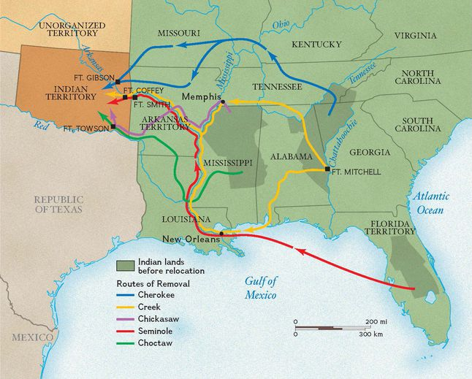
CC

Slide 8
Quiz Topics: Jackson’s Presidency
You will study and know only 1 topic of your choosing. You will be required to write what you know with a thorough answer.

